Slide 1
Pseudo-Lexical Generation
Alex Broadaway, Jon Urrutia, Harris Sinclair
2024-12-05

Slide 2
Pseudo Lexical Generation
Concept
Generation
Example
Use Case

Slide 3
Concept

Slide 4
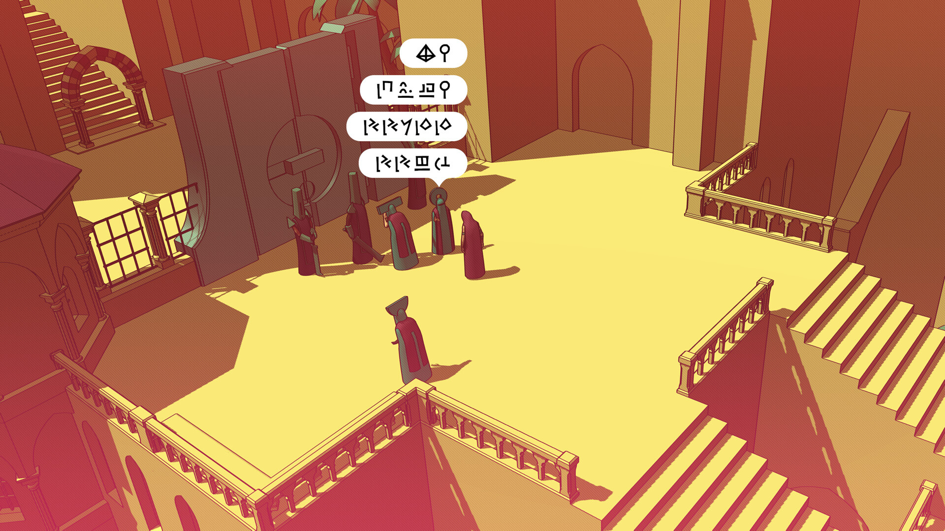
Concept: Chants of Sennaar

Slide 5
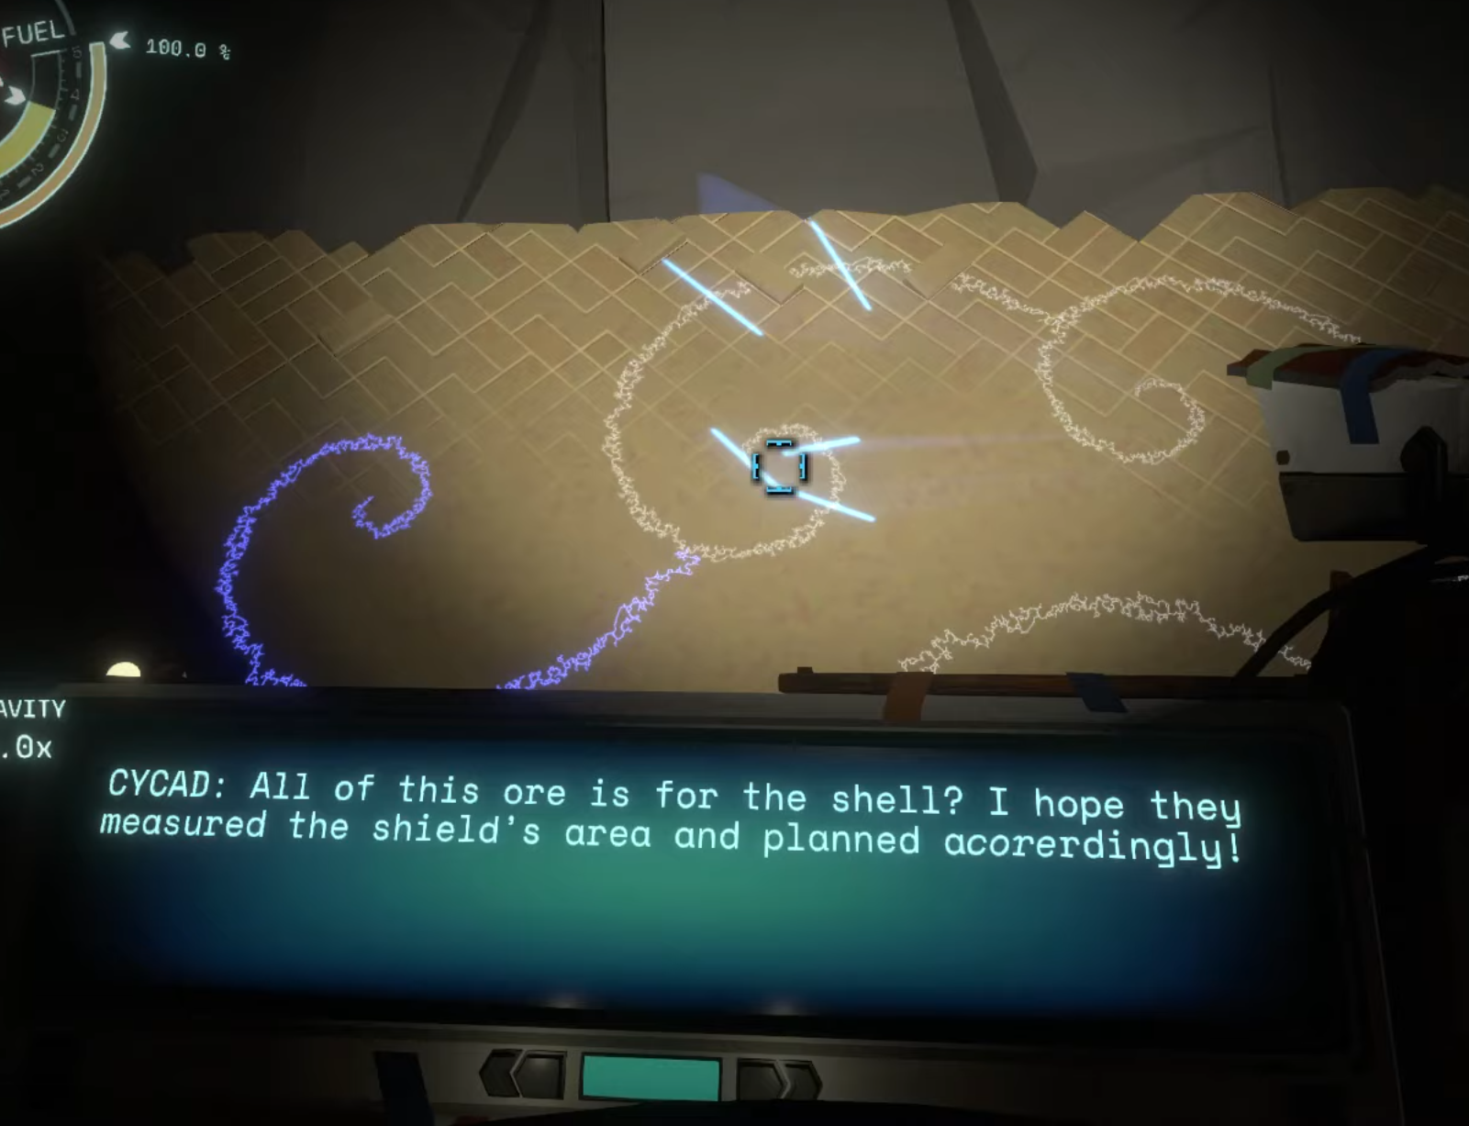
Concept: Outer Wilds

Slide 6
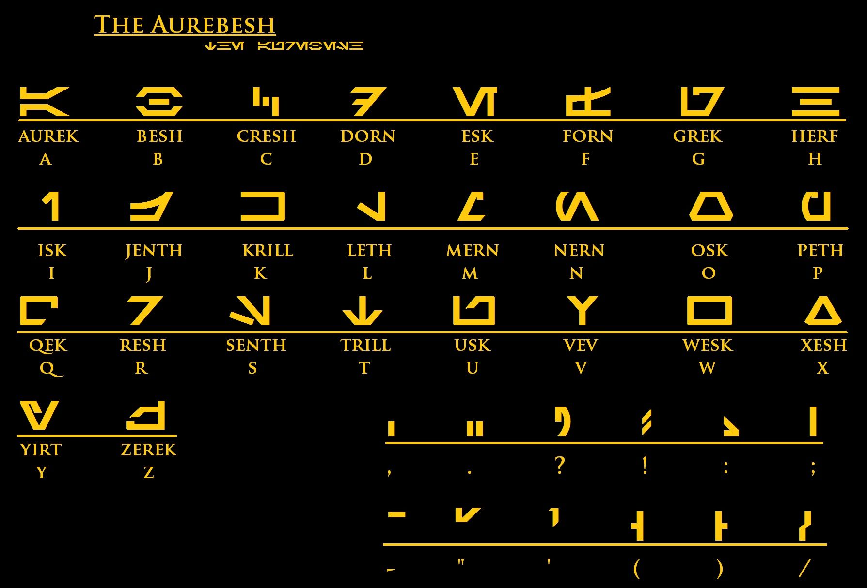
Concept: Aurebesh

Slide 7
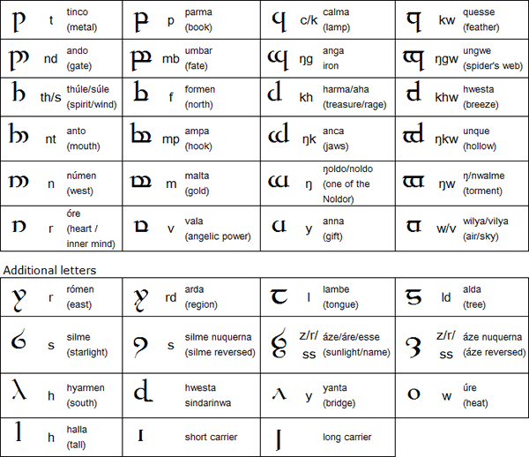
Concept: Quenya (Tolkien’s Elvish)

Slide 8
Concept: Initial Inspiration
How are these narrative languages built?

Slide 9
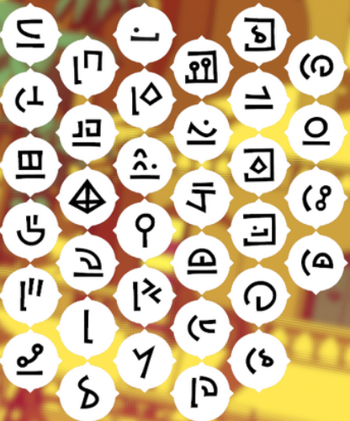
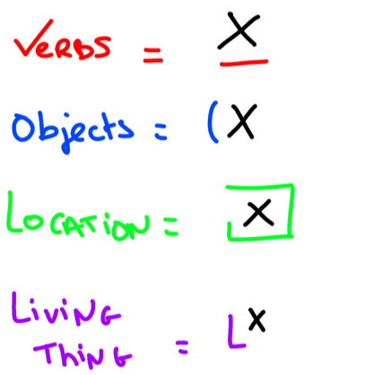
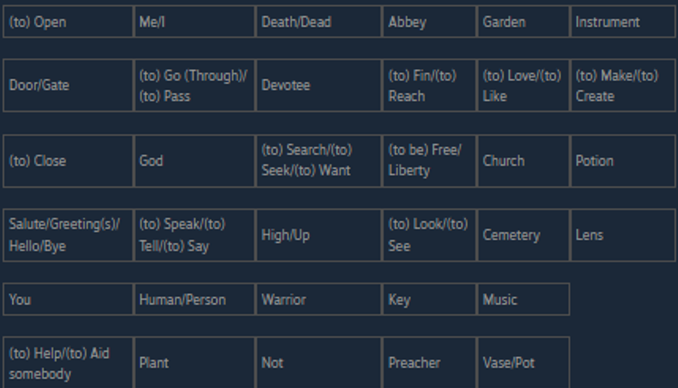
Concept: Chants of Sennaar
Priest’s Language in Chants of Sennaar
Image Credit Aeith on Steam: https://steamcommunity.com/sharedfiles/filedetails/?id=3037327250

Slide 10
Concept: Chants of Sennaar
What kinds of information are encoded?
Parts of Speech
States of Being
Purpose of Use

Slide 11
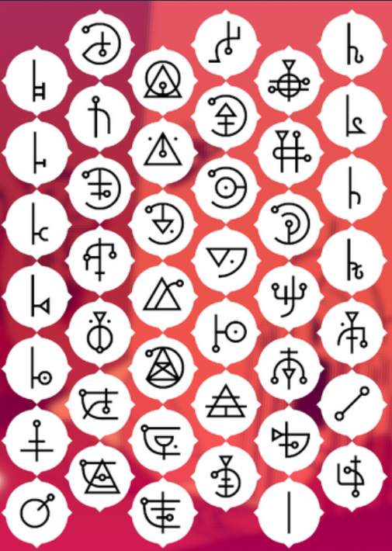
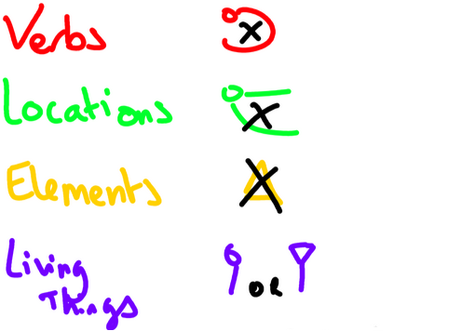
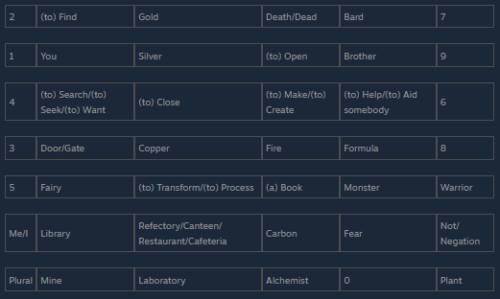
Concept: Chants of Sennaar
Alchemist’s Language in Chants of Sennaar
Image Credit Aeith on Steam: https://steamcommunity.com/sharedfiles/filedetails/?id=3037327250

Slide 12
Concept: Rules
We’ll call these “Identifier” words Traits
Traits are special symbols which carry meaning.
Non Trait Words exist to uniquely identify which instance of a Trait exists.

Slide 13
Concept: Rules
We want to have a symbol for each word in a limited dictionary.
We then get a sense of coherency from using shared trait symbols with unique identifier symbols to produce the sigil for each word.

Slide 14
Generation

Slide 15
Generation: Stages
Symbol Generation has three steps
Serializer
Generator
Compositor

Slide 16
Generation: Serializer
The Serializer reads and sorts the dictionary.
Example Word | Example Traits
Door | Object
Monster | Living, Evil
Flee | Action

Slide 17
Generation: Symbol Generator
The Symbol Generator produces Symbols
Symbols are just composed lines.
Line length is determined with Gaussian Randomness
Lines are grouped together as “Strokes”

Slide 18
Generation: Compositor
The Compositor Constructs Unique Word Sigils
Words are pulled from the Dictionary
Each Word has a Symbol Generated
Trait Symbols are then merged with Word Symbols

Slide 19
Example

Slide 20
Example: Post Serializer
Example Word | Example Traits | Symbols
Door | Object
Monster | Living, Evil

Slide 21
Example: Generator (Traits)
Object
Living
Evil

Slide 22
Example: Generator (Identifiers)
Door
Monster

Slide 23
Example: Compositor
Example Word | Example Traits | Symbols
Door | Object
Monster | Living, Evil

Slide 24
Use Case

Slide 25
Use Case
Media Already Want Something Like This
Chants of Sennaar
Outer Wilds’ Nomai Spirals
Star Wars’ Aurabesh
Tolkien’s Elvish

Slide 26
Use Case
Help people make cool things

Slide 27
Questions, Comments, Concerns?

